Slide 1
Chapter 9
UML for Database Application Design

Slide 2
Objectives
When fact-finding techniques are used in the database system development lifecycle.
The types of facts collected throughout the database system development lifecycle.
The types of documentation produced throughout the database system development lifecycle.
The most commonly used fact-finding techniques.
How to use each fact-finding technique and the advantages and disadvantages of each.

Slide 3
Objectives
About a Web-based DVD rental company called StayHome Online Rentals.
How to use fact-finding techniques in the database planning, systems definition, and requirements collection and analysis stages of the database system development lifecycle.
Examples of the types of documentation created in the database planning, systems definition, and requirements collection and analysis stages of the database system development lifecycle.

Slide 4
Fact-finding
The formal process of using techniques such as interviews and questionnaires to collect facts about systems, requirements, and preferences.
Many occasions for fact-finding during the database system development lifecycle.
Particularly crucial to the early stages of the lifecycle, including the database planning, system definition, and requirements collection and analysis stages.

Slide 5
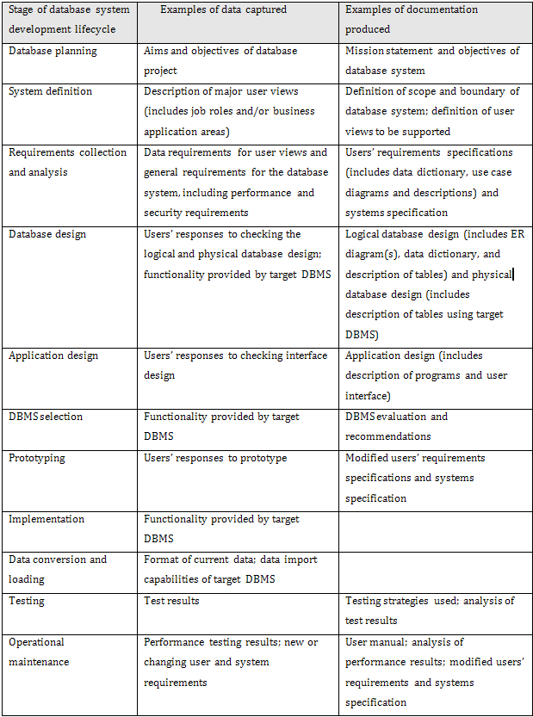
What facts are collected and when?

Slide 6
Fact-finding techniques
A database developer normally uses several fact-finding techniques during a single database project, including:
  Examining documentation,
  Interviewing,
  Observing the business in operation,
  Research,
  Questionnaires.

Slide 7
  Examining documentation
Examining documents, forms, reports, and files associated with the current system, is a good way to quickly gain some understanding of the system.

Slide 8
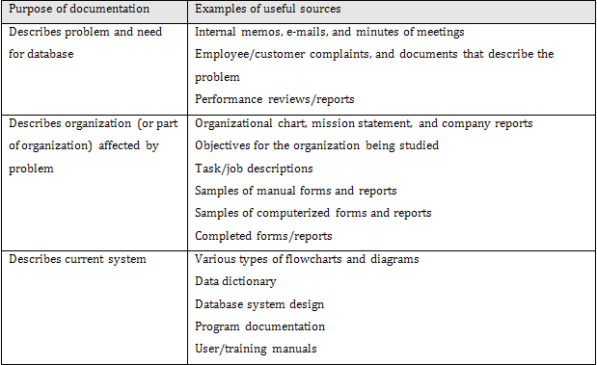
Examples of documentation to examine

Slide 9
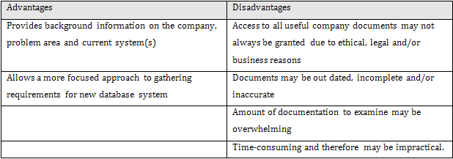
Advantages / disadvantages of examining documentation

Slide 10
Interviewing
Interviewing is the most commonly used, and normally most useful, fact-finding technique.
Objectives include:
  finding out and/or checking facts;
  generating user interest and/or feelings of involvement;
  identifying requirements and/or gathering ideas and opinions.

Slide 11
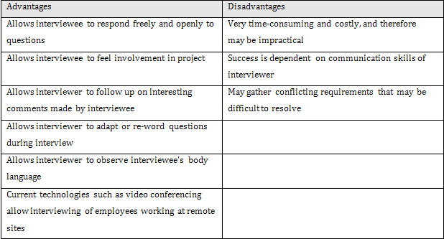
Advantages / disadvantages of interviewing

Slide 12
Interviewing
Management activities that allow stages of database system development lifecycle to be realized as efficiently and effectively as possible.
Should be integrated with overall IS strategy of the organization.
Includes creation of the mission statement and mission objectives for the database system.

Slide 13
Interviewing
There are two types of interviews: unstructured and structured.
  Unstructured interviews are conducted with only a general objective in mind and with few, if any, specific questions.
  In structured interviews, the interviewer has a specific set of questions to ask the interviewee.

Slide 14
Interviewing
There are two types of questions: open-ended and closed.
  Open-ended questions allow the interviewee to respond in any way that seems appropriate.
  Closed-ended questions restrict answers to either specific choices or short, direct responses.

Slide 15
Observing the business in operation
One of the most effective techniques.
Can either participate in, or watch a person perform activities to learn about the system.

Slide 16
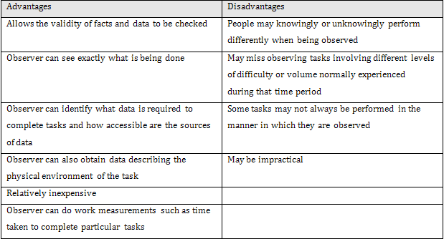
Advantages / disadvantages of observation

Slide 17
Research
Useful to research the application and problem.
Computer trade journals, reference books, and the Internet are good sources of information.
May find how others have solved similar problems, plus you can learn whether or not software packages exist to solve your problem.

Slide 18
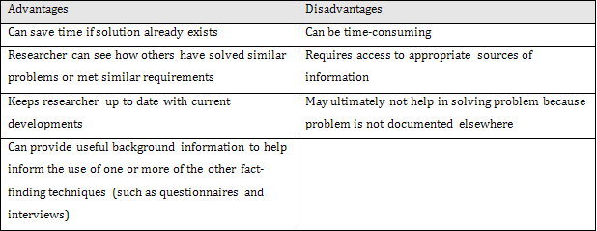
Advantages / disadvantages of research

Slide 19
Questionnaires
Can conduct surveys through questionnaires.
Questionnaires are special-purpose documents that allow you to gather facts from a large number of people while maintaining some control over their responses.

Slide 20
Questionnaires
There are two formats for questionnaires: free-format and fixed-format.
Free-format questionnaires offer the respondent greater freedom in providing answers.
Fixed-format questionnaires contain questions that require specific responses from individuals.

Slide 21
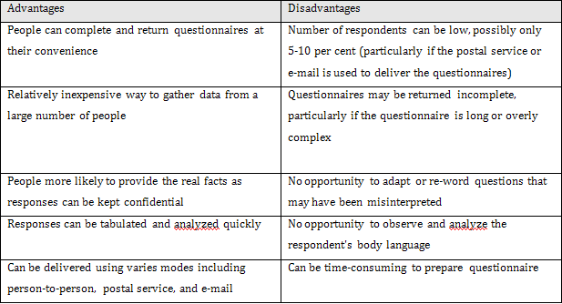
Advantages / disadvantages of questionnaires

Slide 22
The StayHome case study
This case study describes aon online DVD rental company called StayHome, which rents out DVDs to its members. The first warehouse and head offices of StayHome was established in 1982 in Seattle but the company has now grown and has three additional warehouses in different states of the United States.

Slide 23
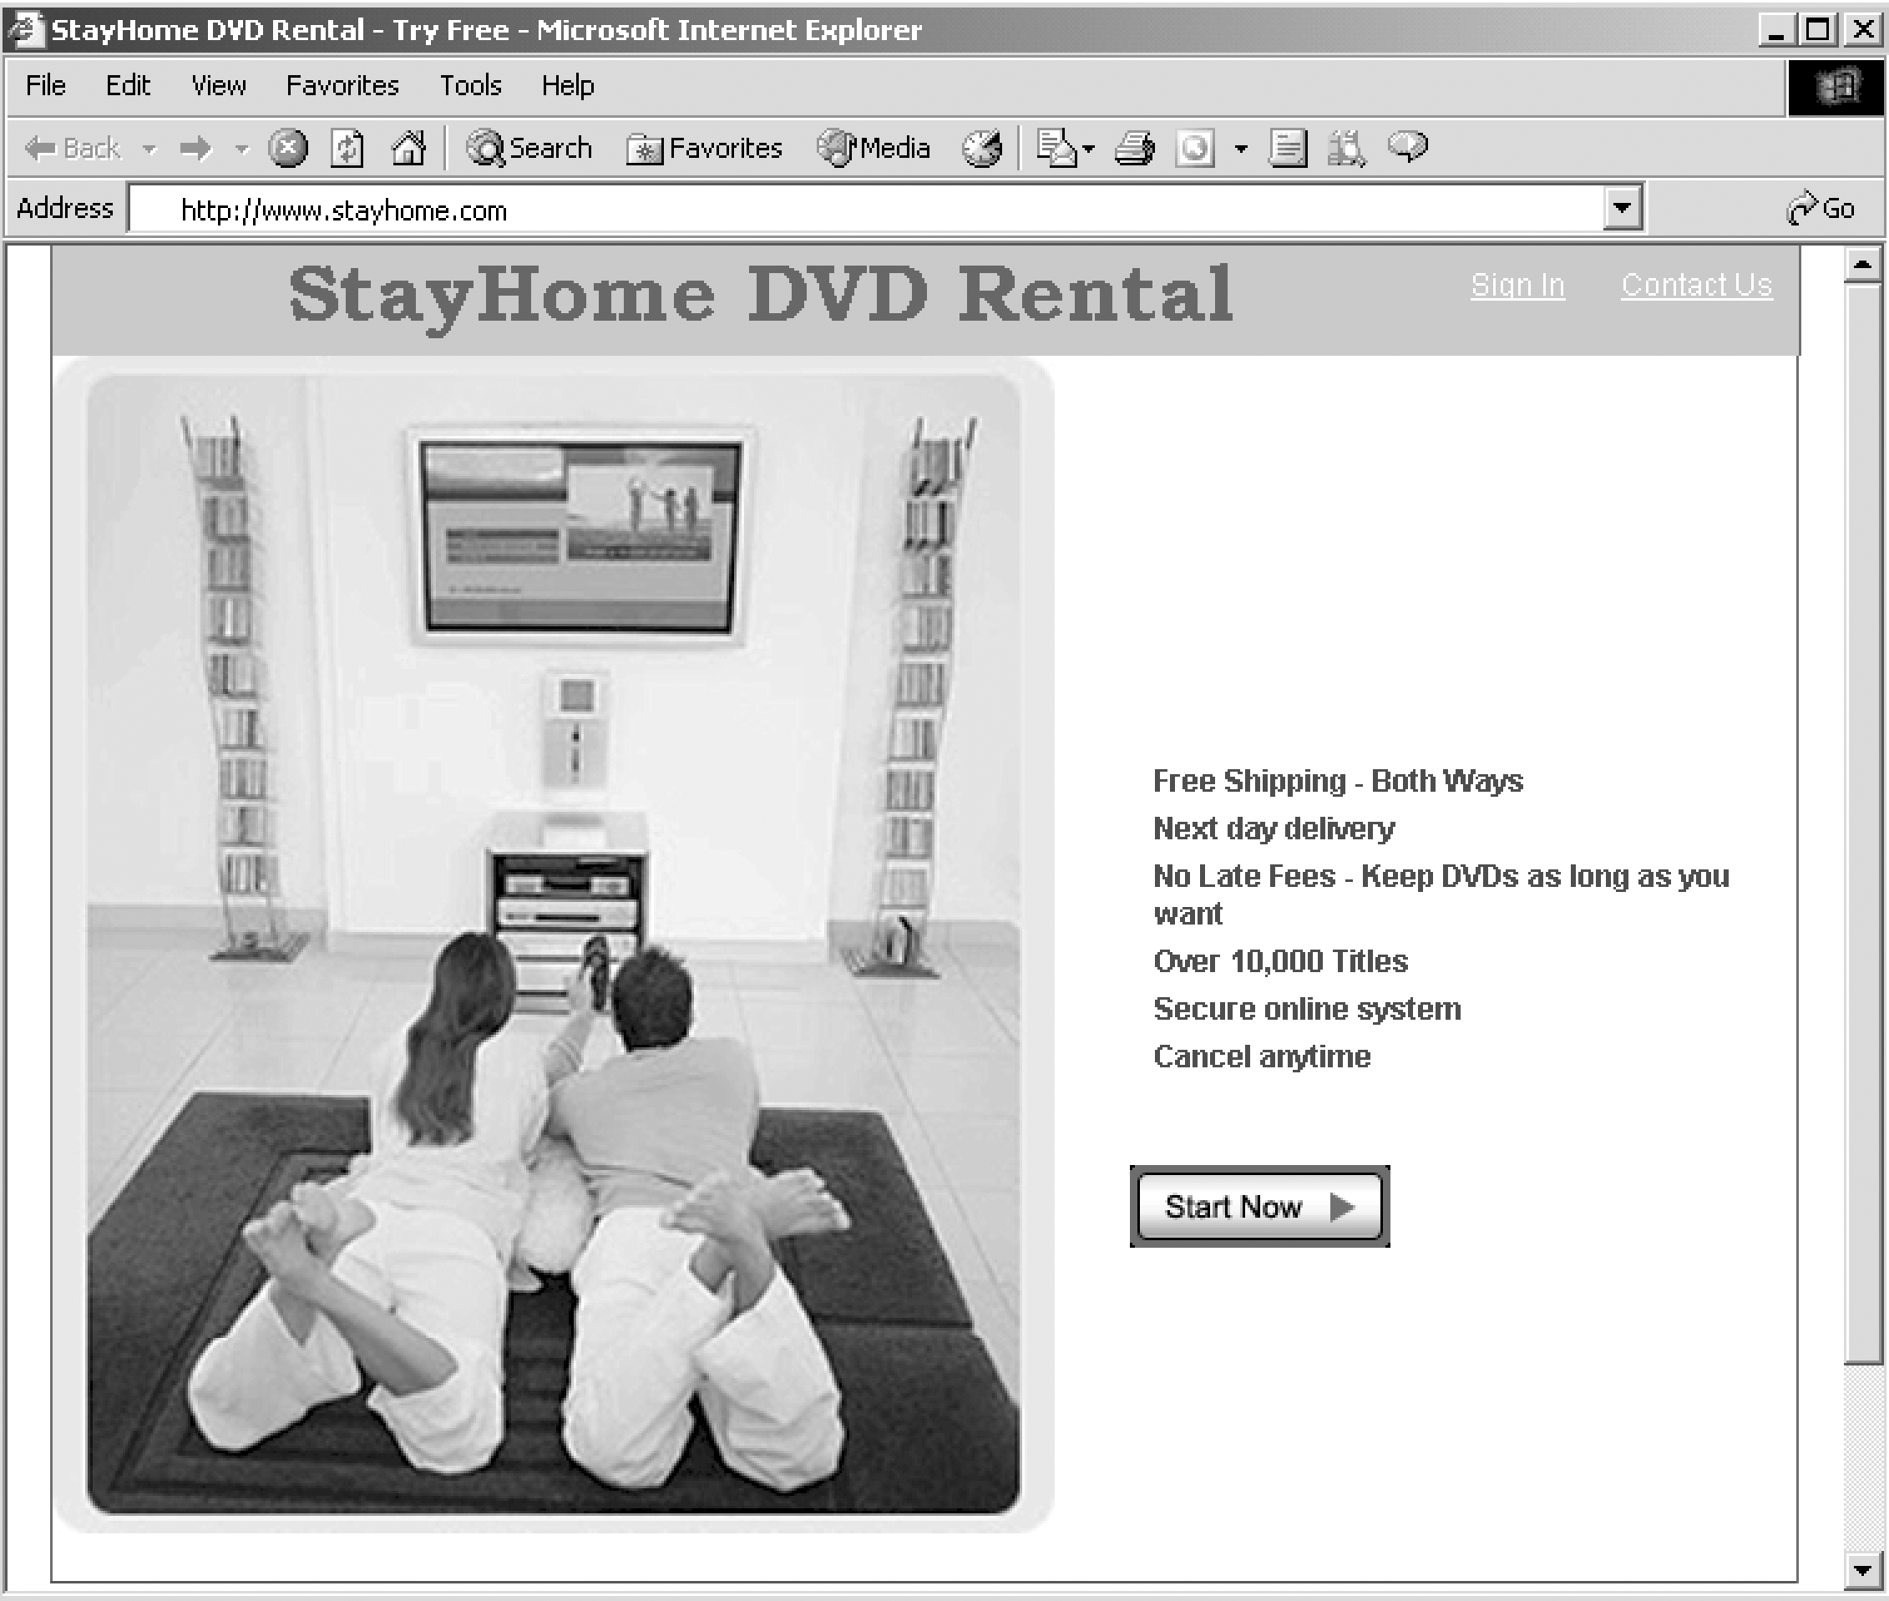
Home page for the StayHome Online Rentals Web site

Slide 24
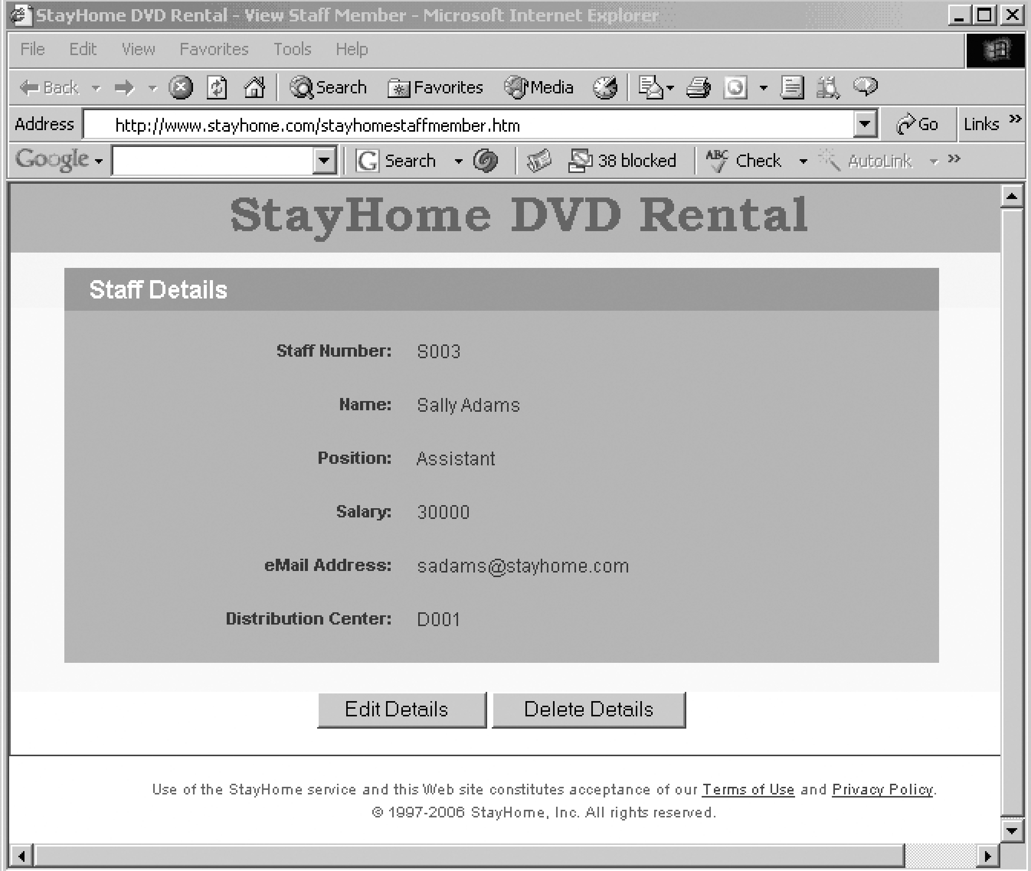
Web page of member of staff called Sally Adams

Slide 25
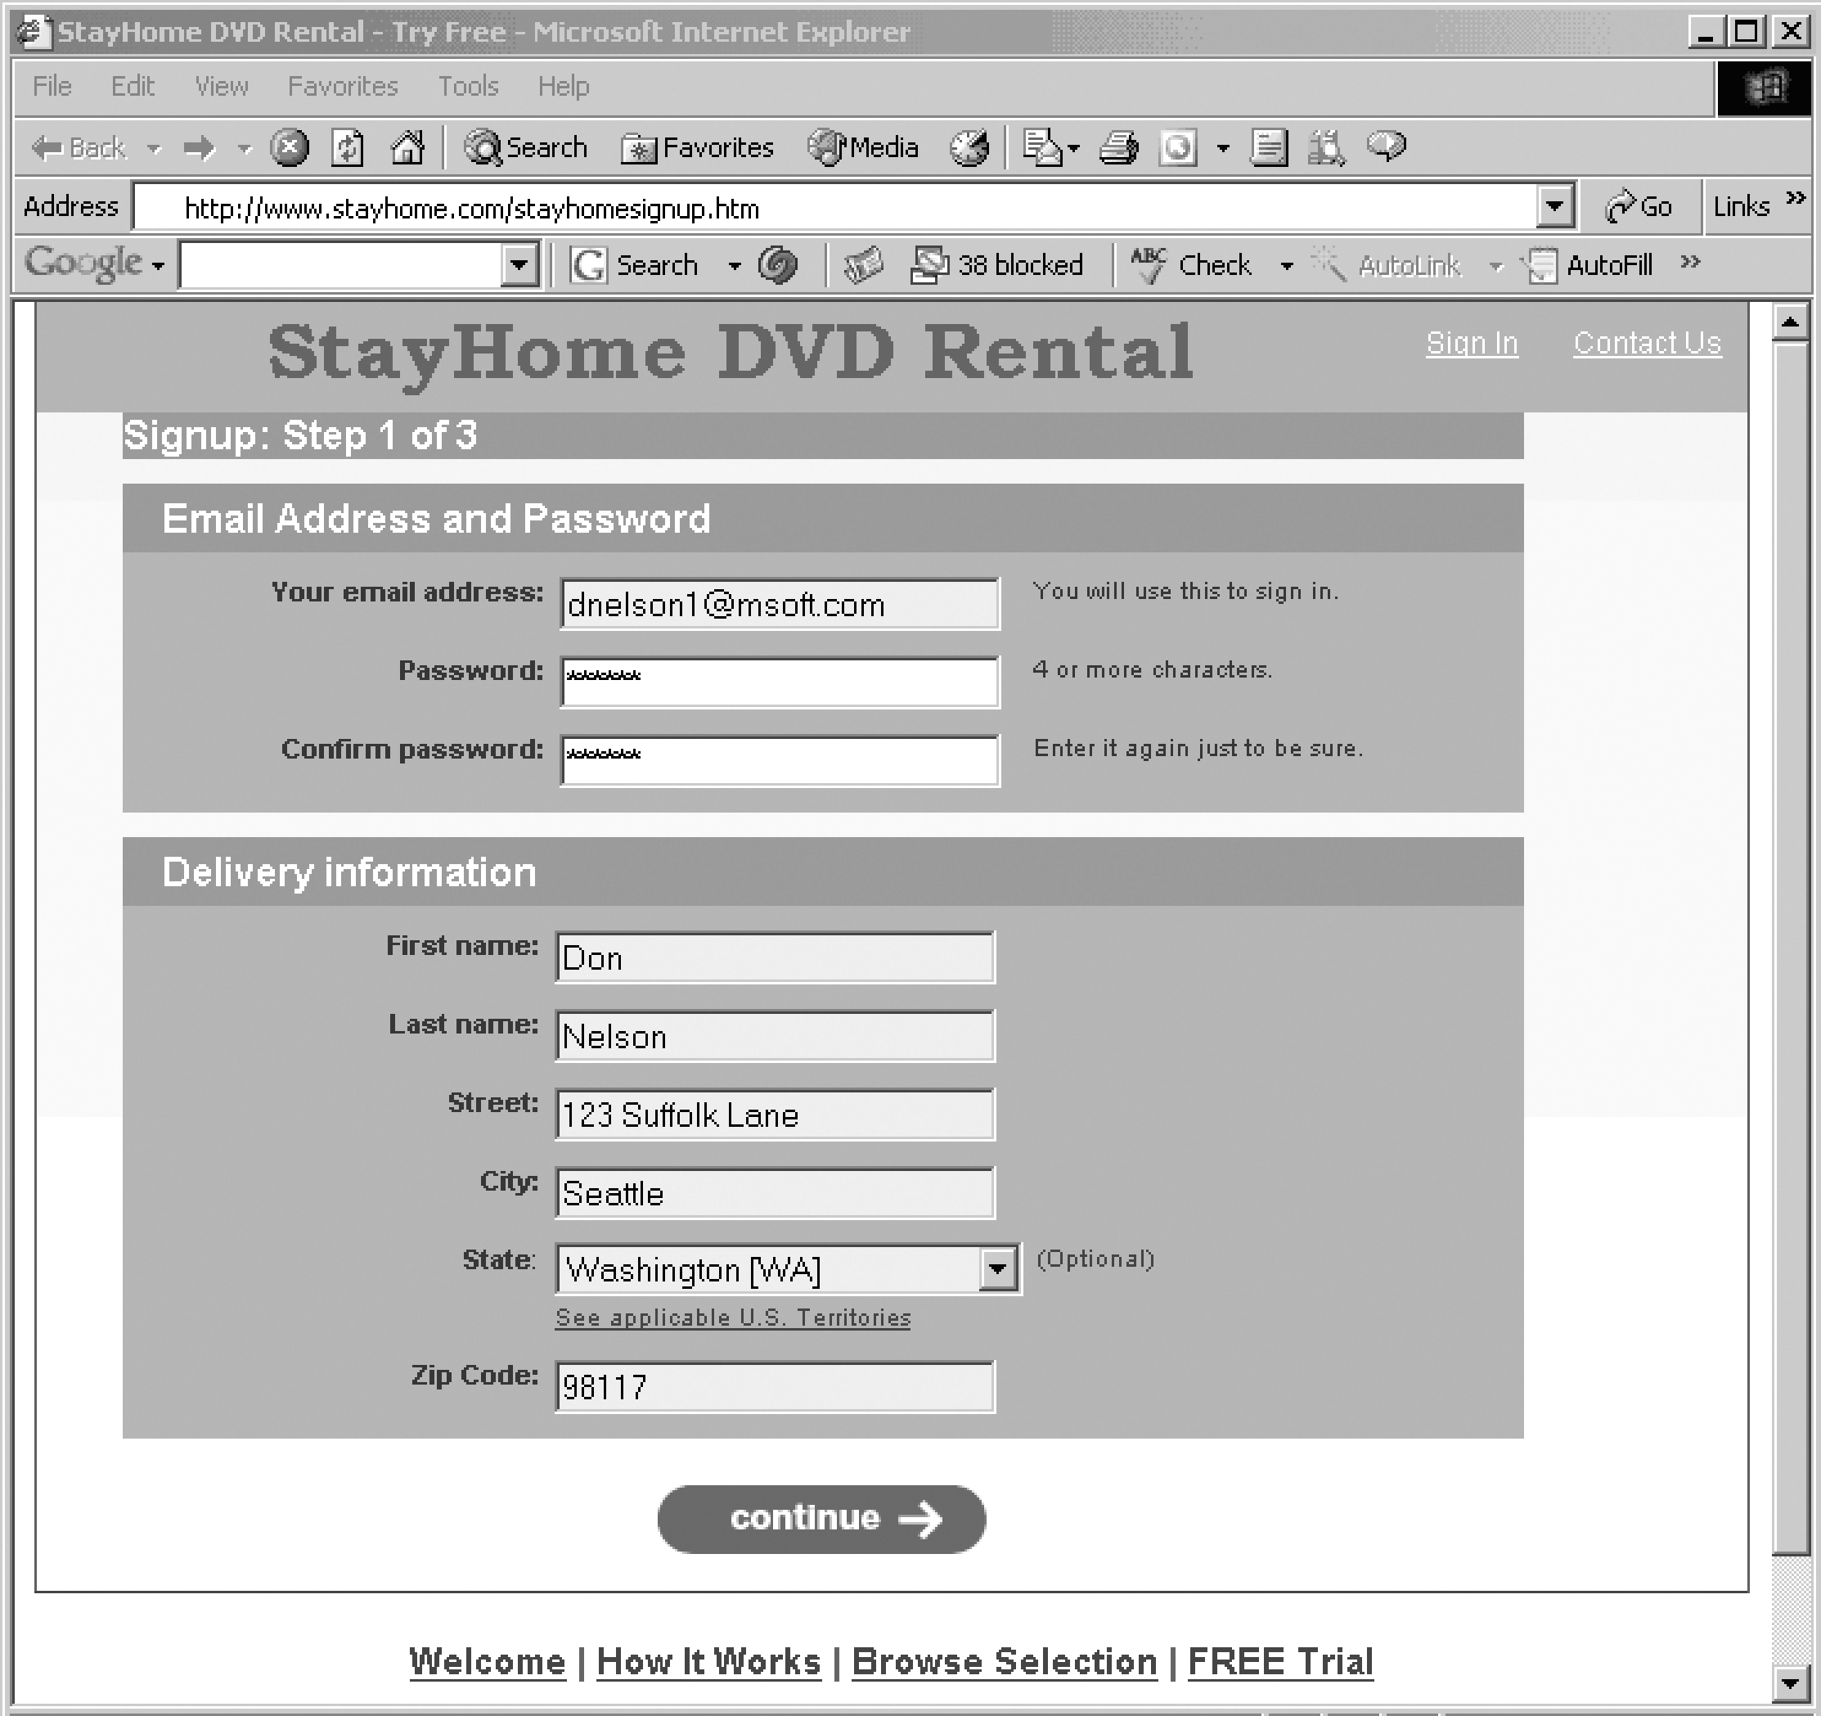
Web page (1) for new member of StayHome Online Rentals

Slide 26
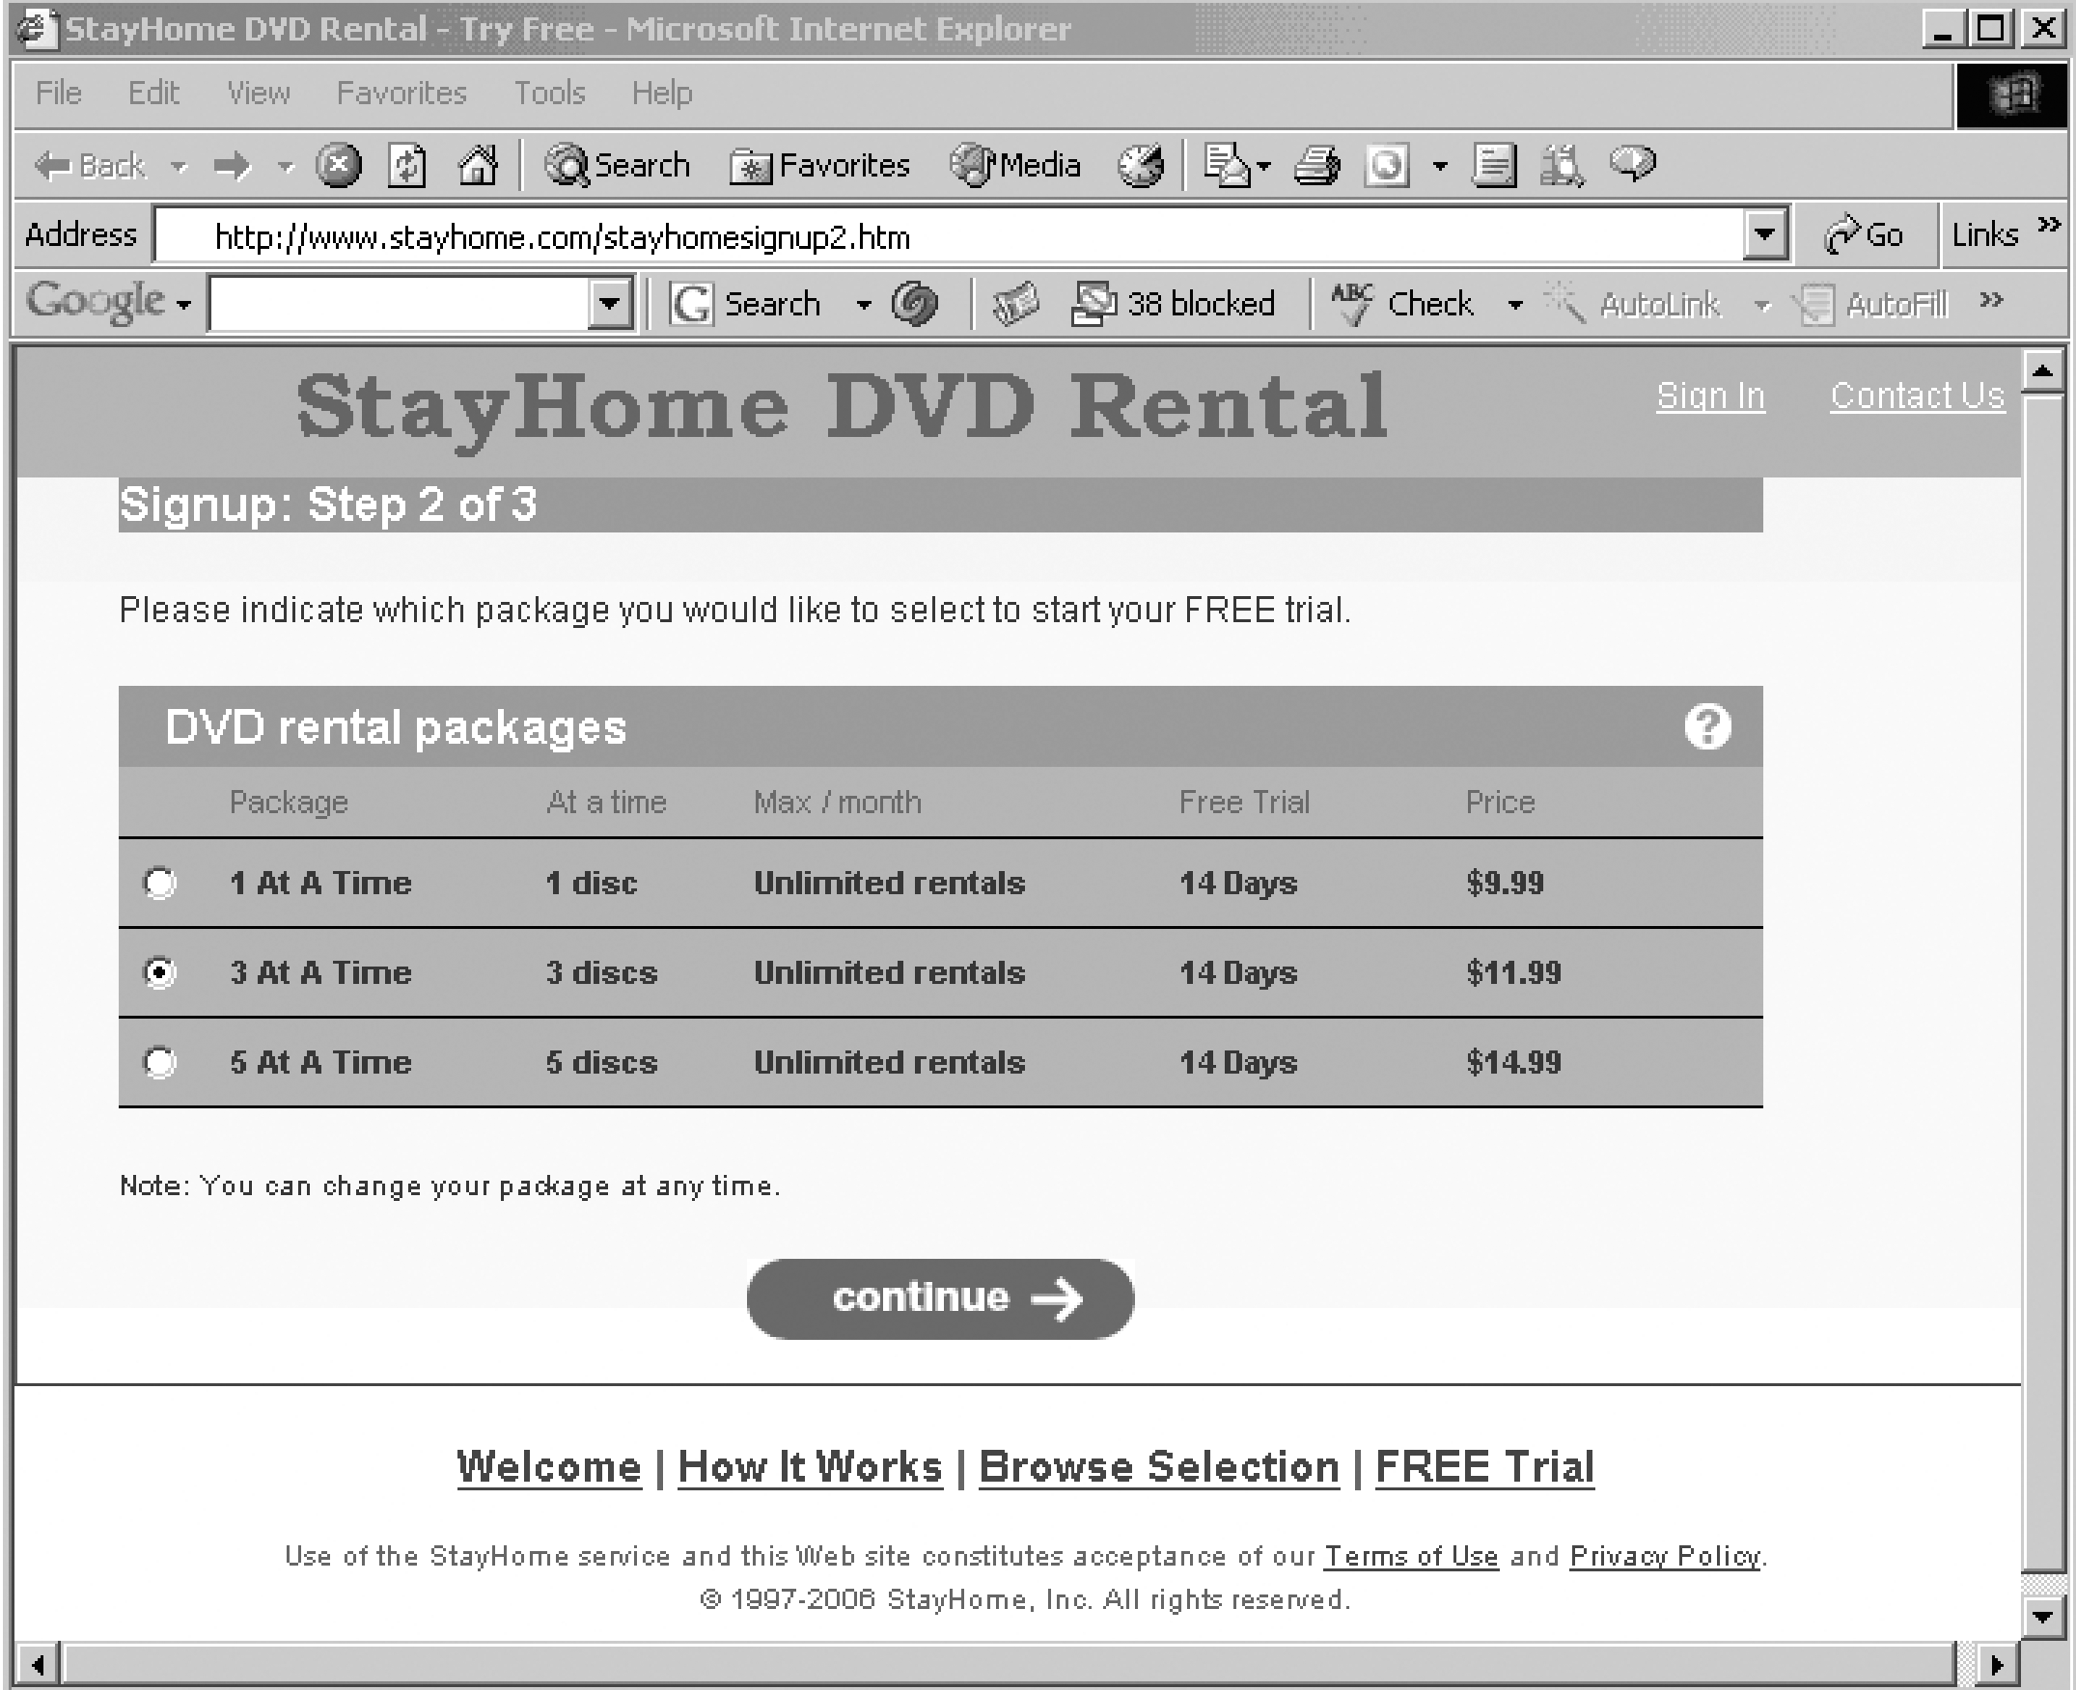
Web page (2) for new member of StayHome Online Rentals

Slide 27
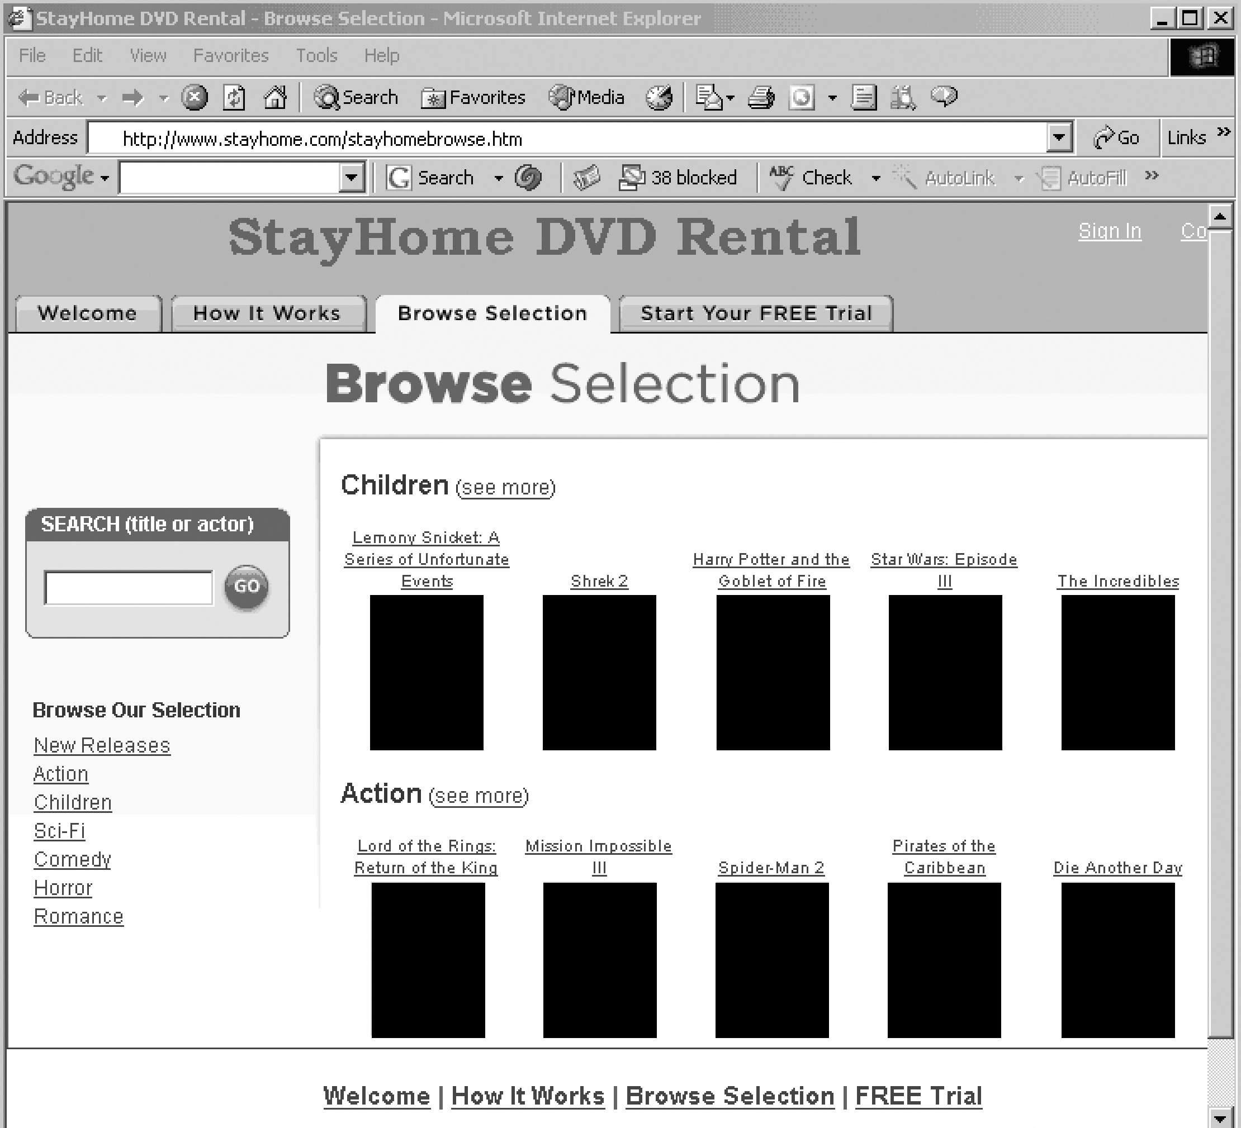
Web page for browsing DVDs available at StayHome Online Rentals

Slide 28
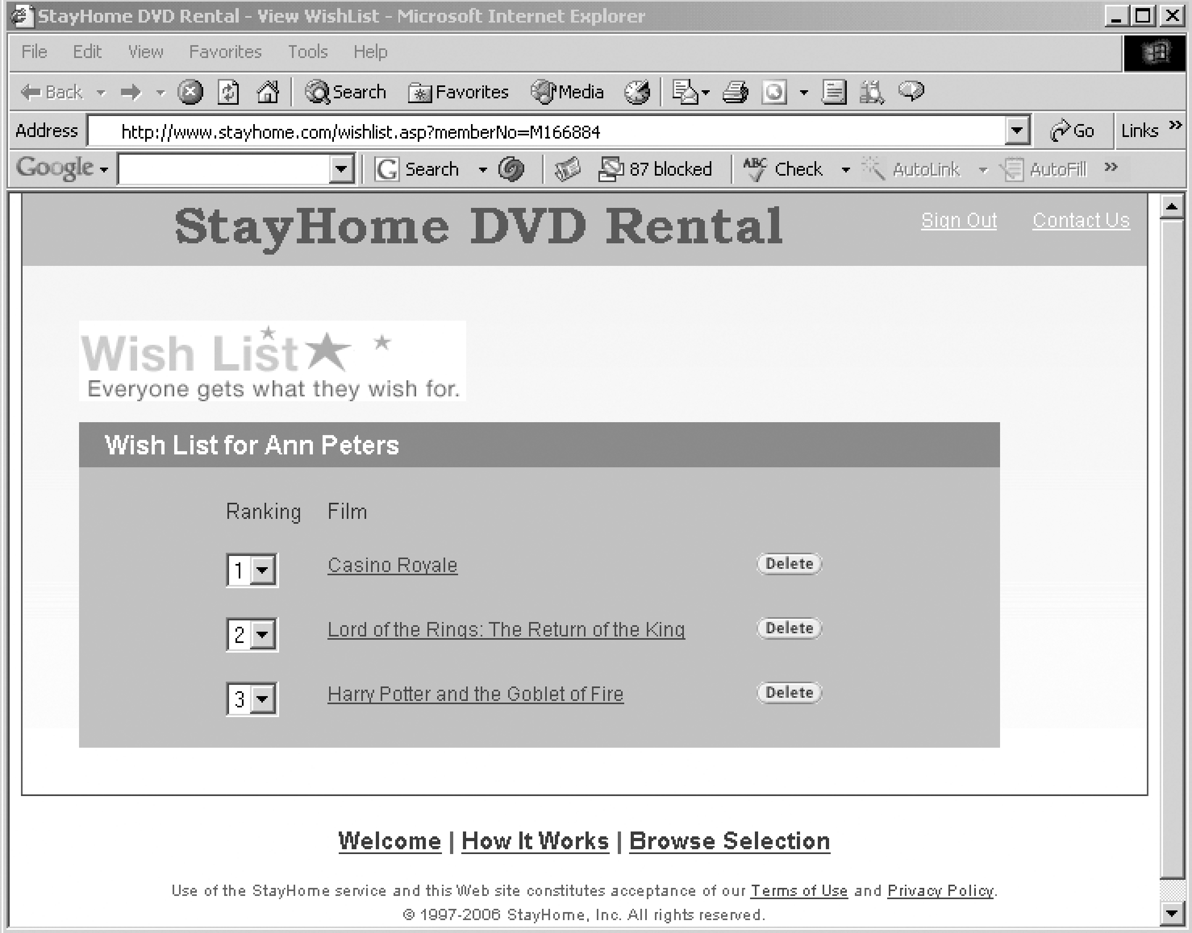
An example of the DVDs that Ann Peters wishes to view

Slide 29
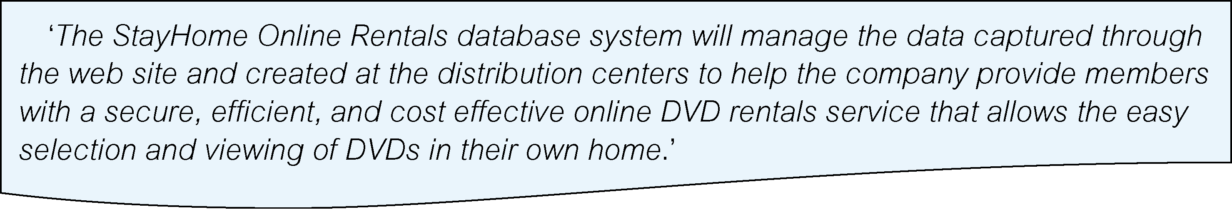
StayHome case study – database planning (mission statement)

Slide 30
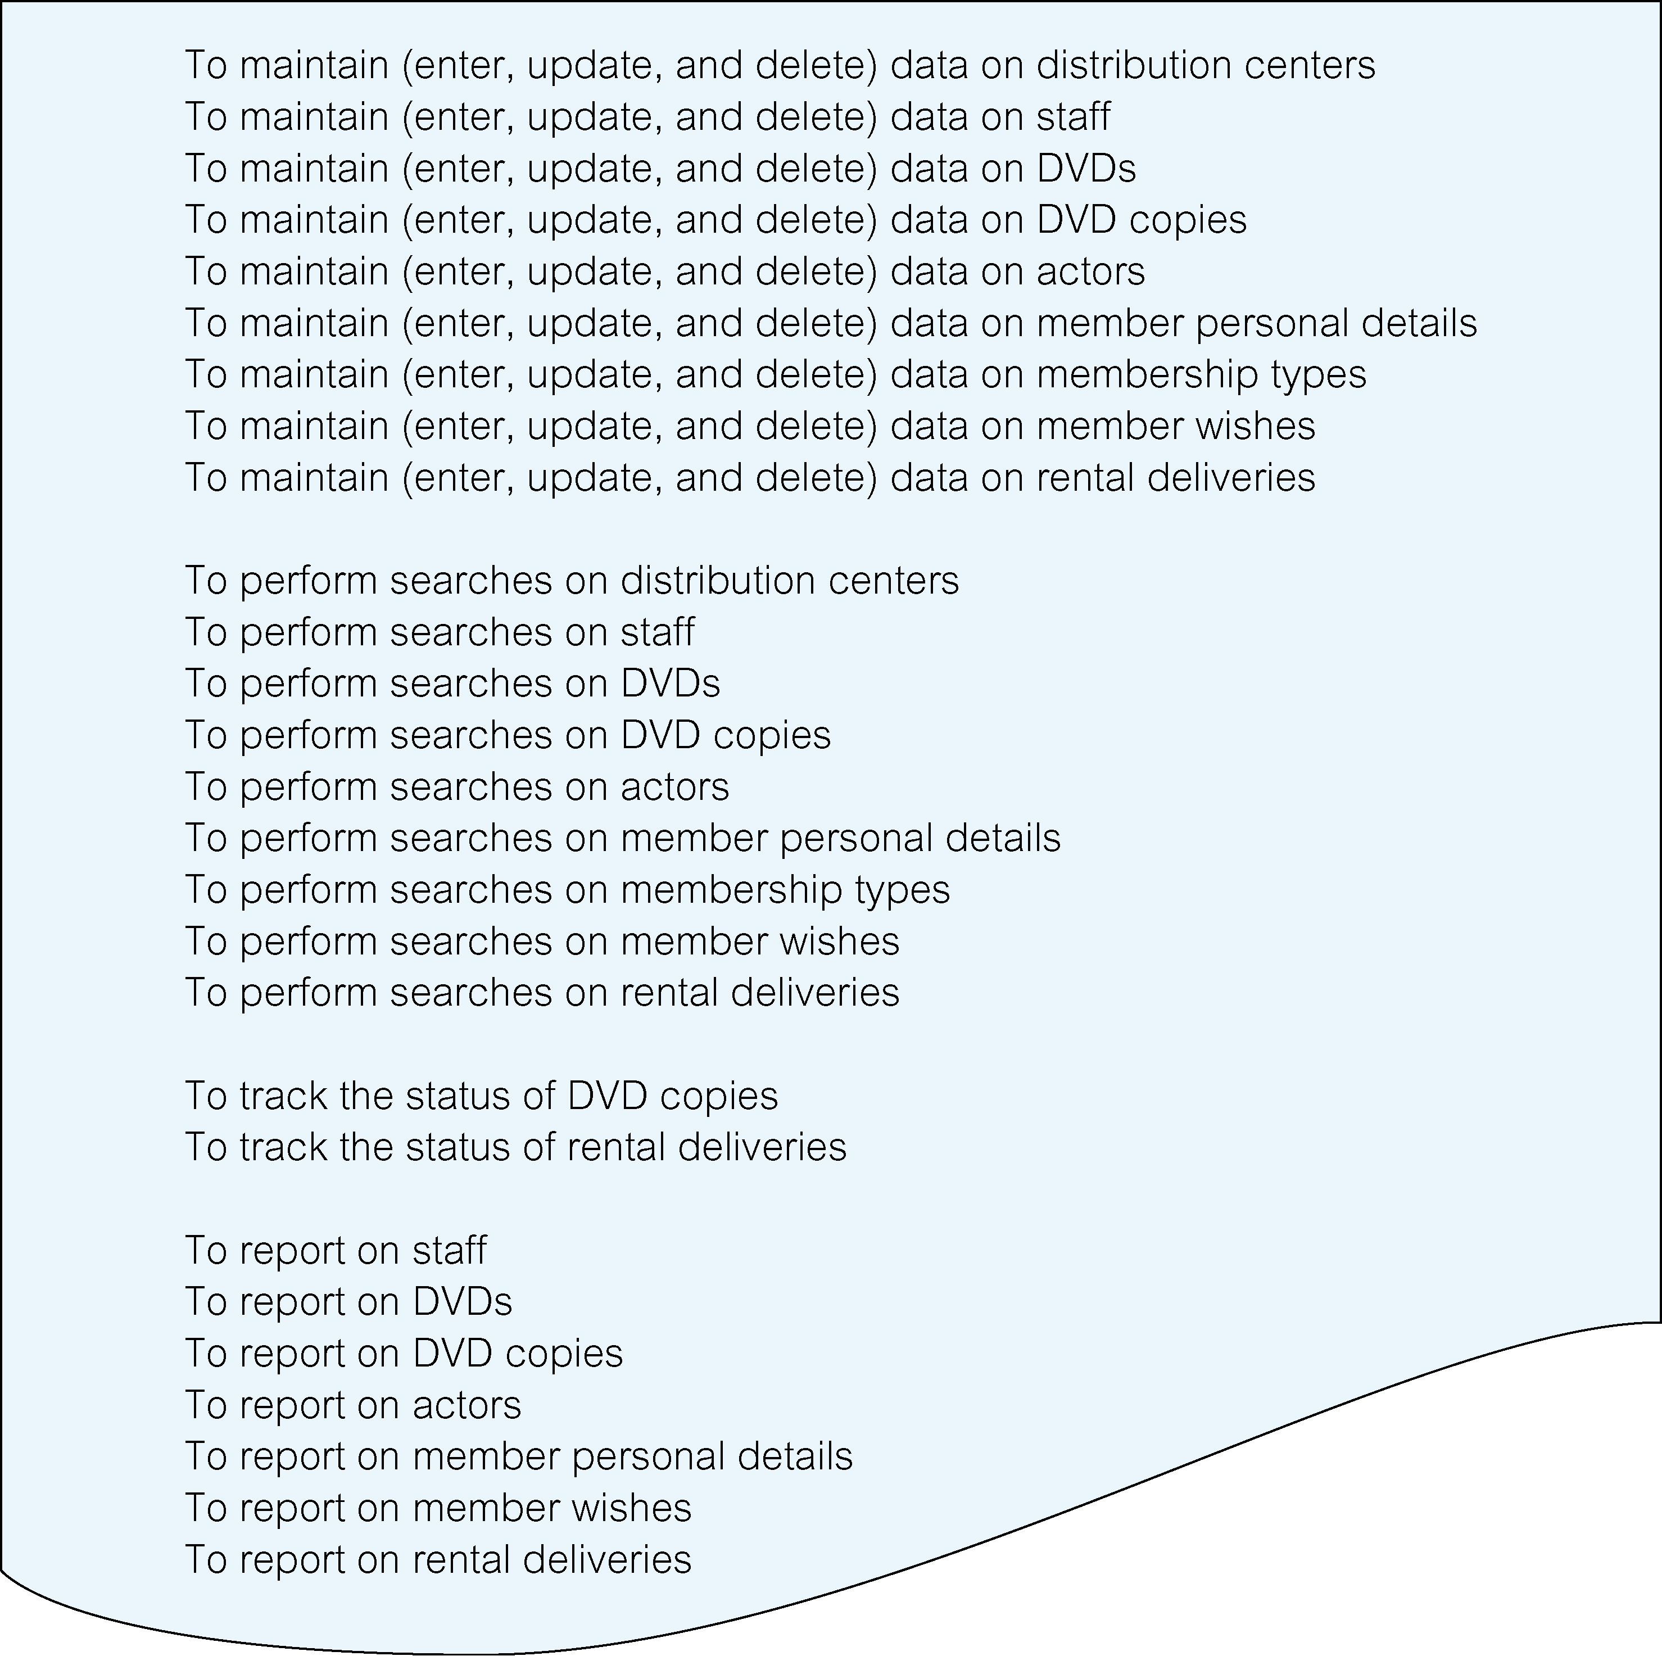
StayHome case study – database planning (mission objectives)

Slide 31
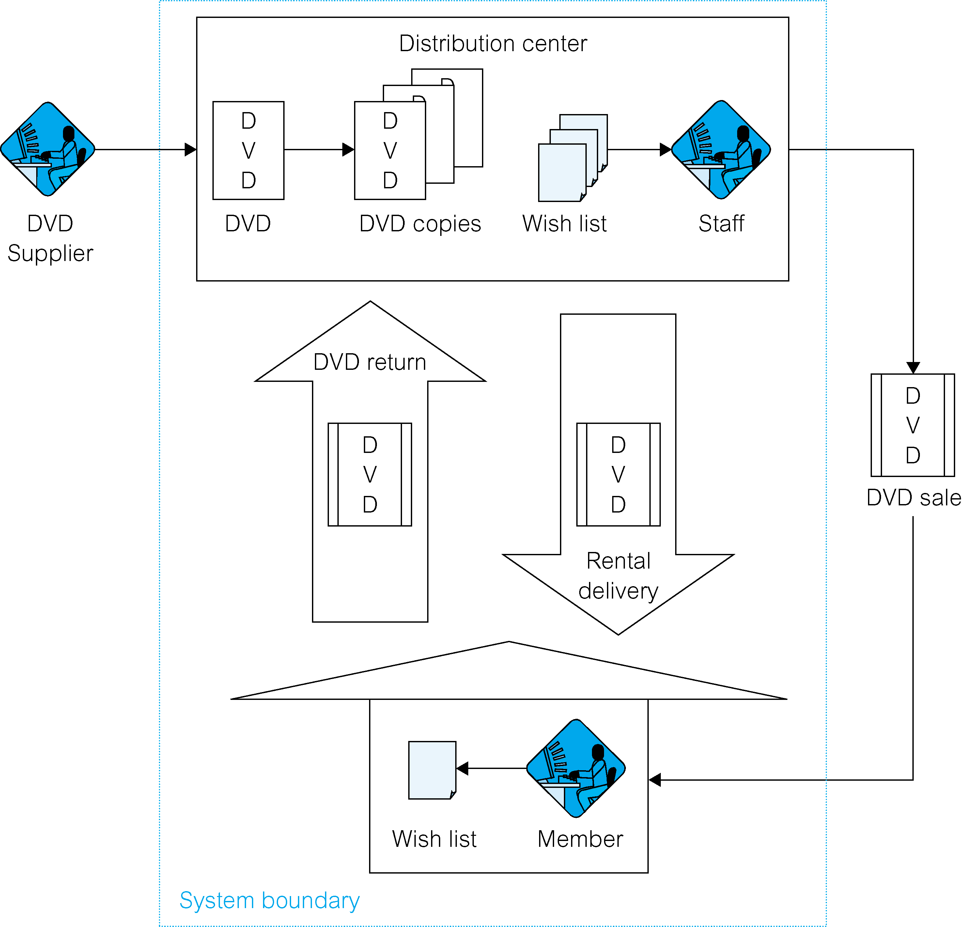
StayHome case study – system definition (system Boundary)

Slide 32
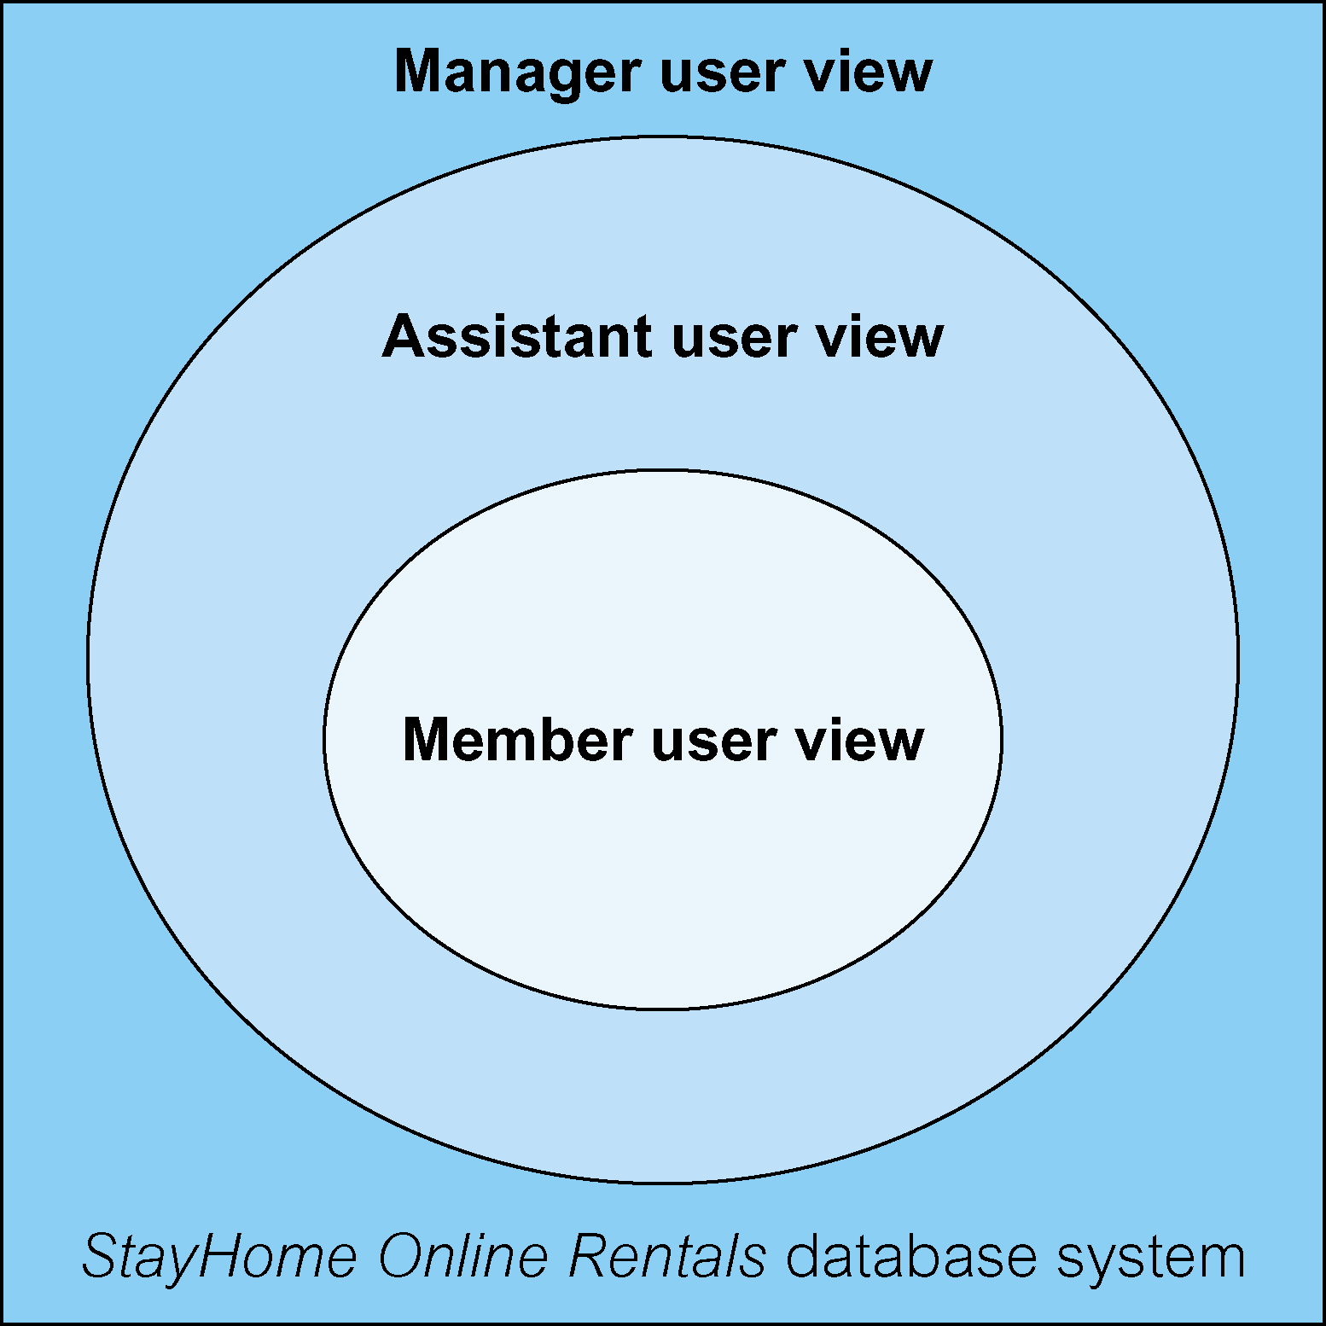
StayHome case study – system definition (user views)

Slide 33
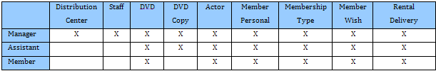
Cross-reference of user views with the main types of data

Slide 34
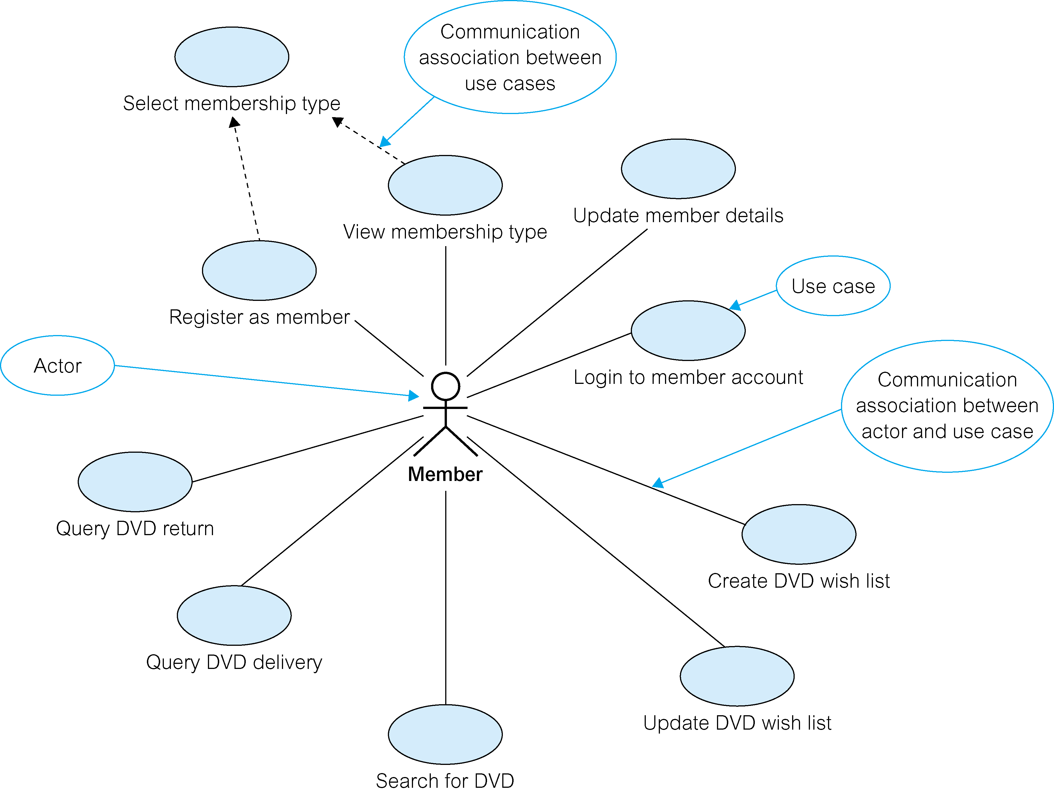
Use case diagram for the Member user view

Slide 35
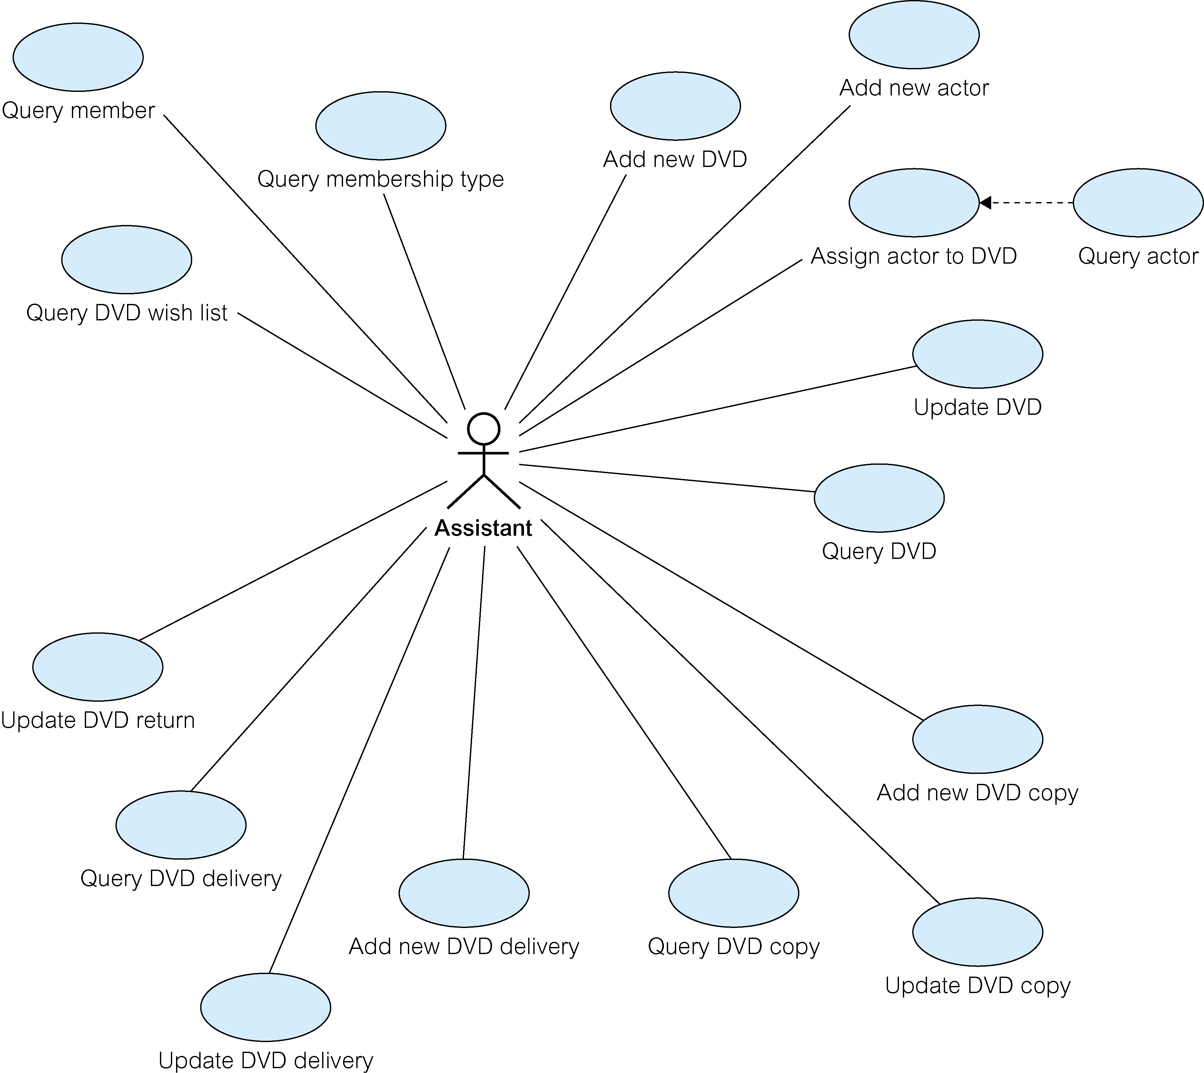
Use case diagram for the Assistant user view

Slide 36
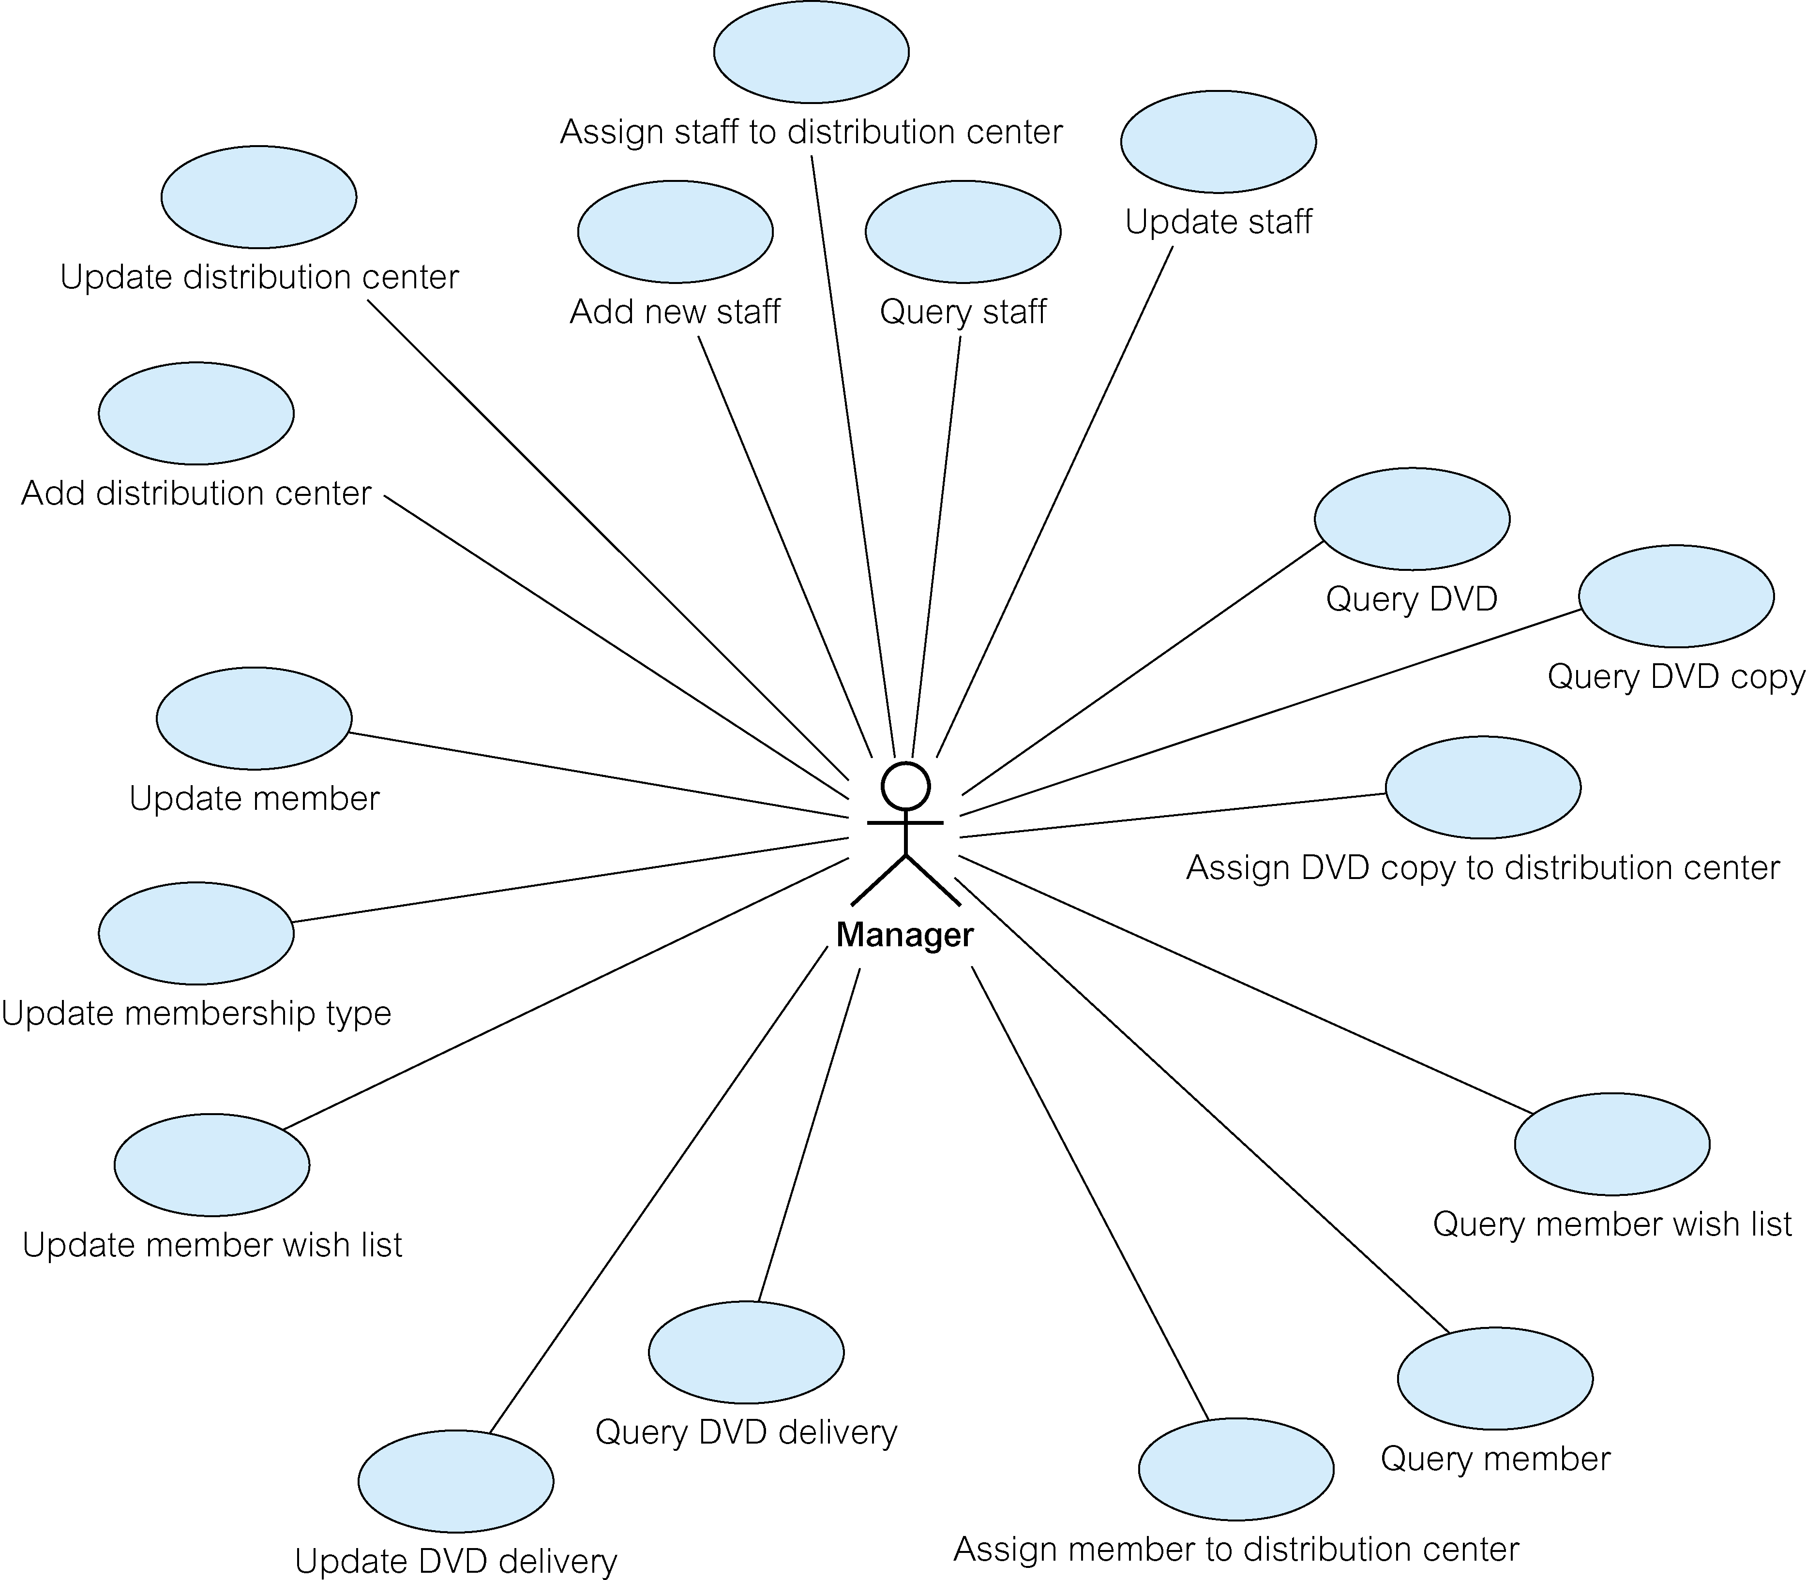
Use case diagram for the Manager user view

